Slide 1
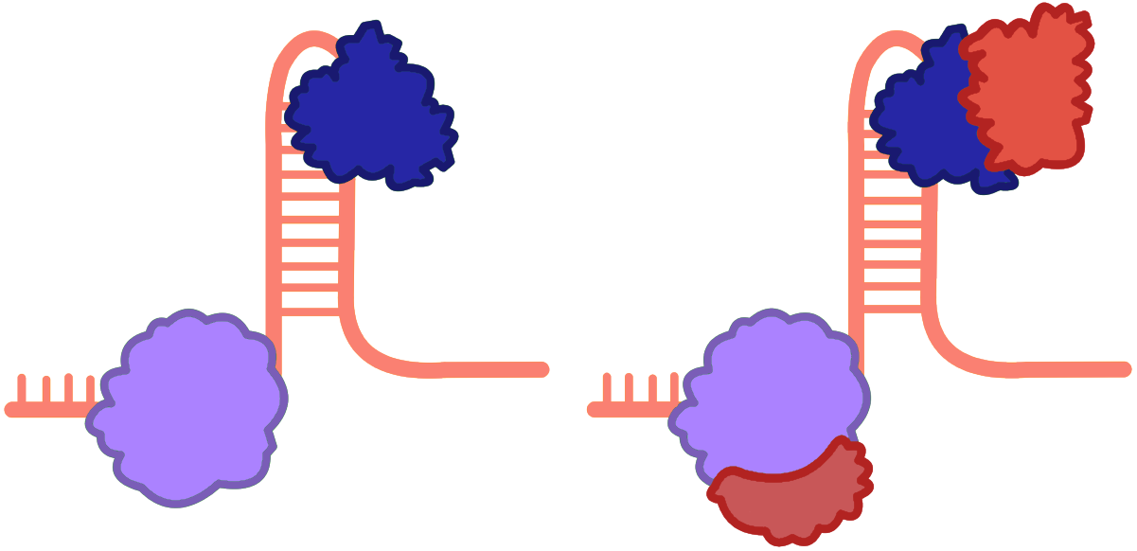
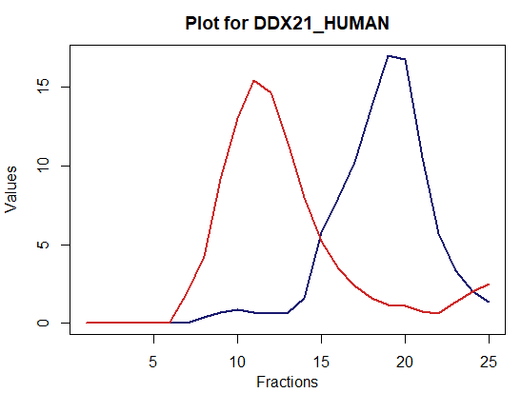
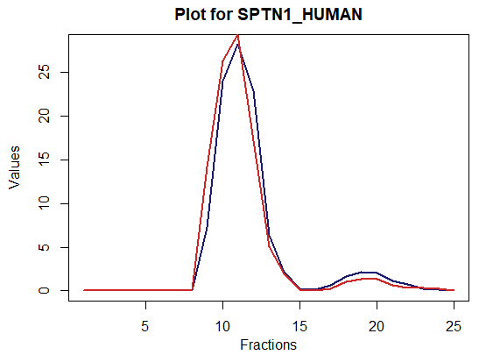
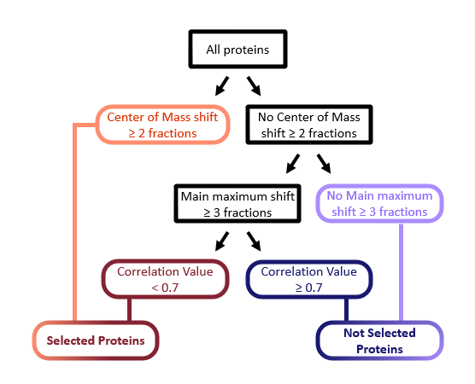
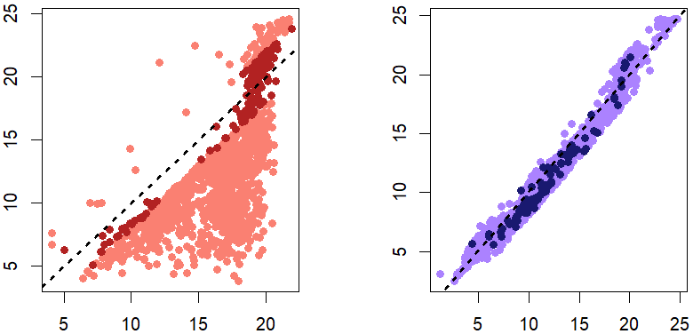
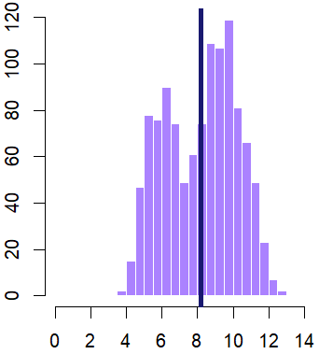
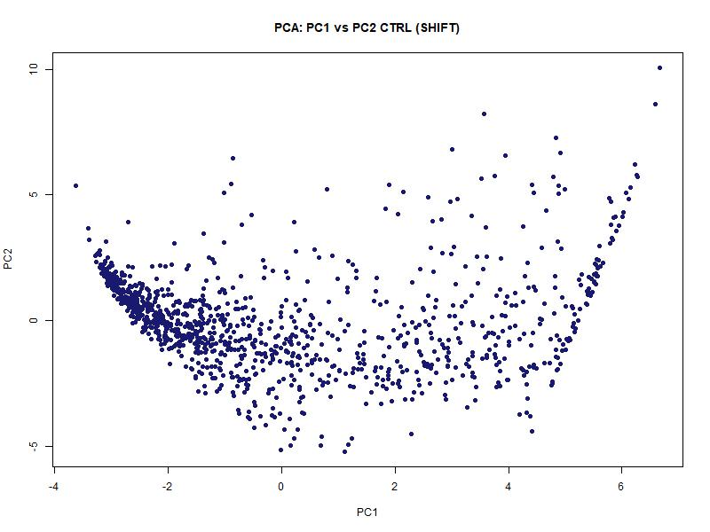
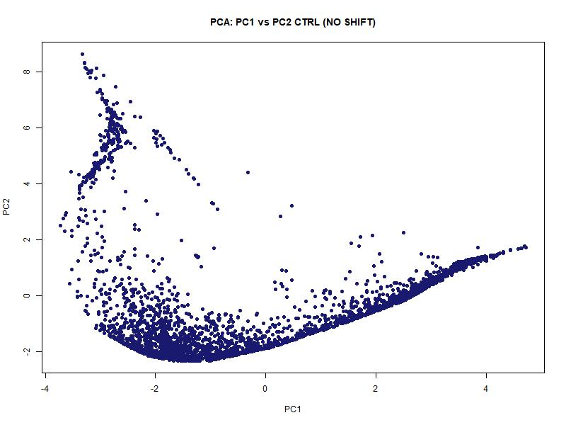
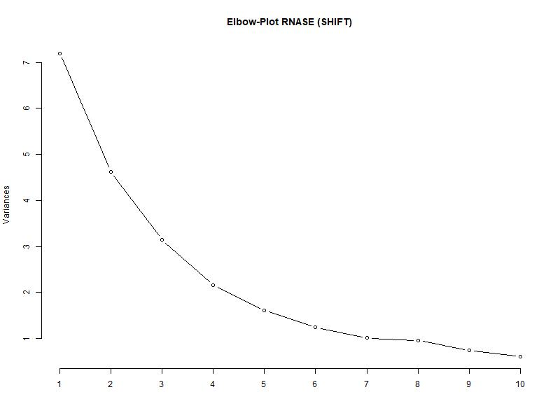
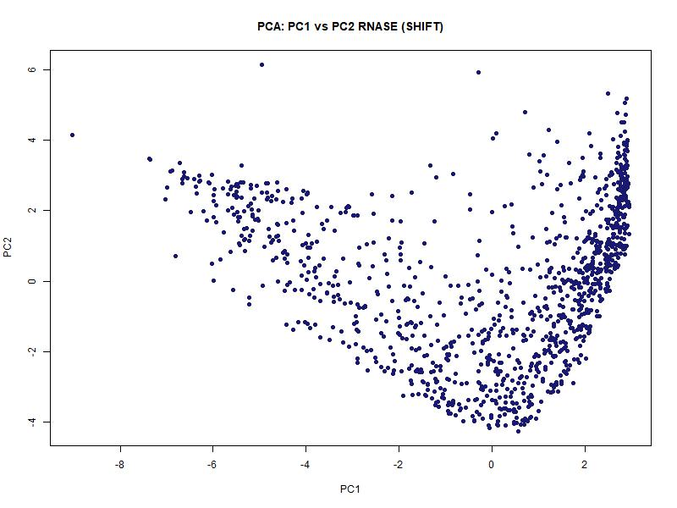
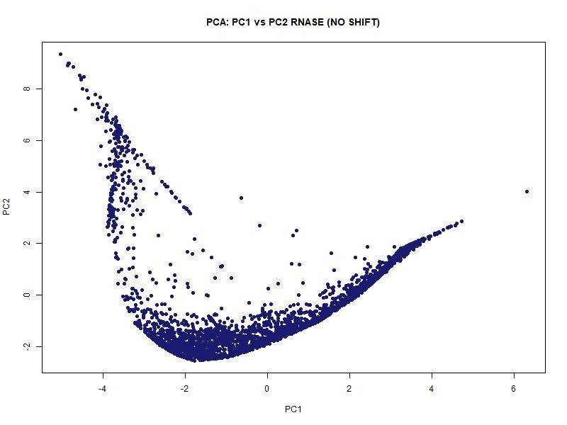
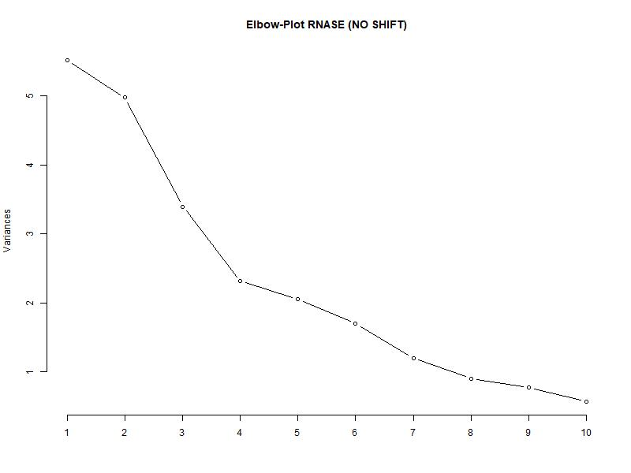
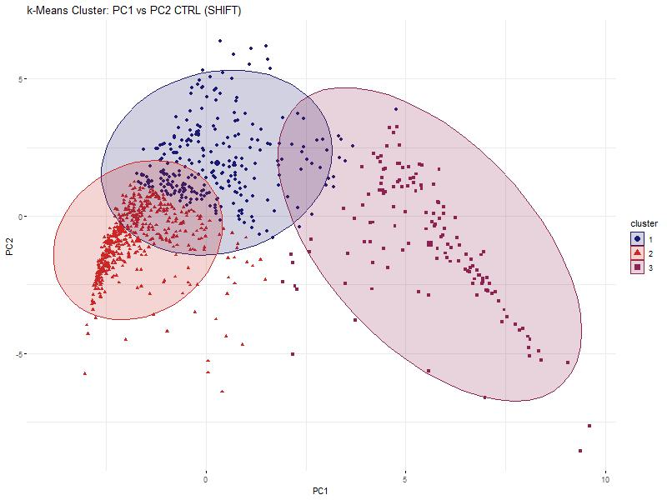
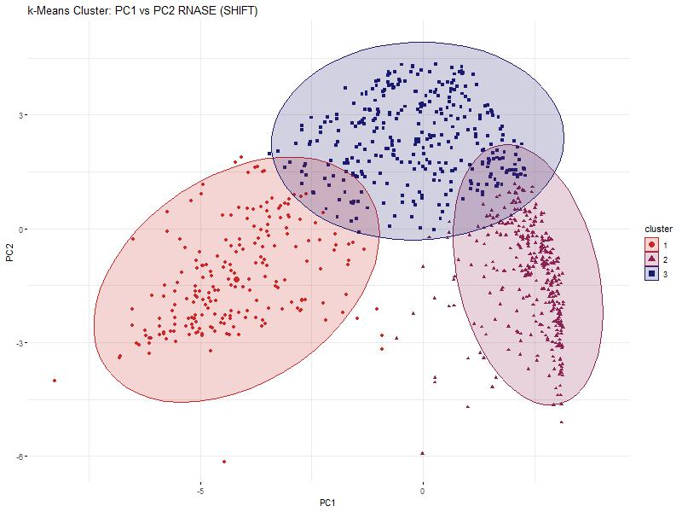
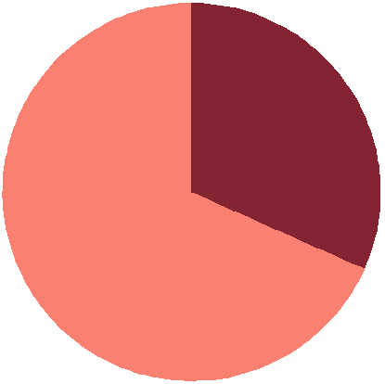
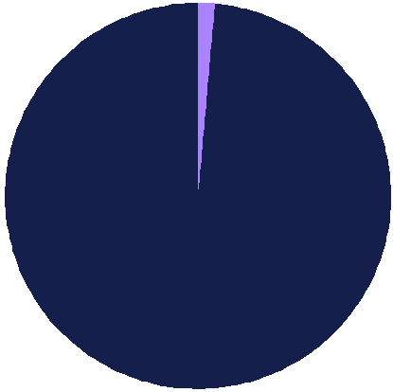


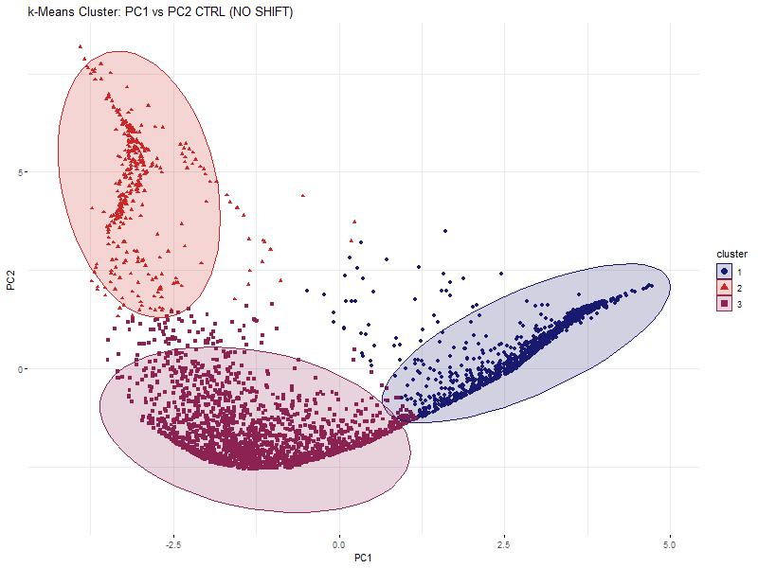
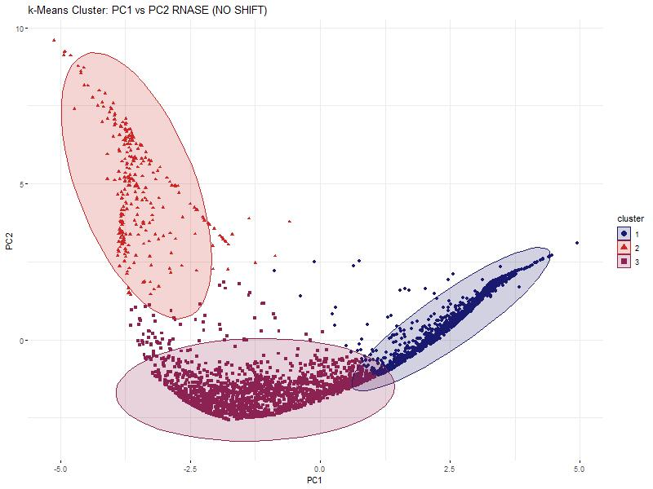

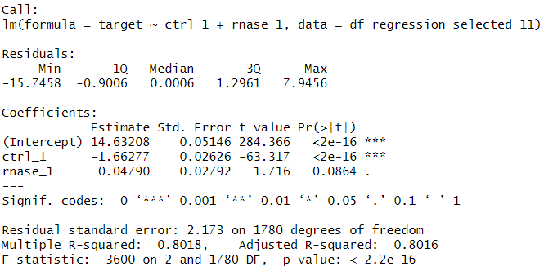
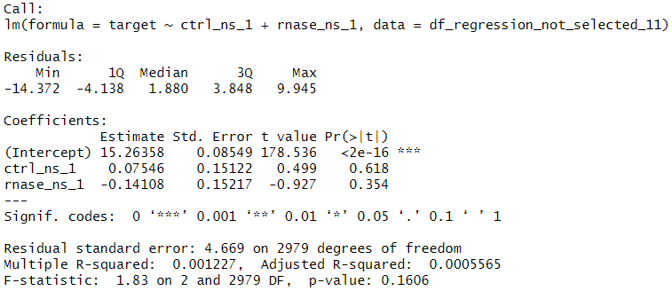

Hidden Alliances:
RNA-Dependent Protein Interactions
in non-synchronized HeLa-Cells
Baureis, J., Ferdin, J., Nicklas, B., Wintel, L.
Data Analysis Project Molecular Biotechnology SS2025
1
https://media.discordapp.net/attachments/942220665635880990/1391120974107250830/image.png?ex=686abdde&is=68696c5e&hm=aba124b02f32de4a0951fec1e1f4ec30cc92823908418468efea0b60f3d38706&=&format=webp&quality=lossless
Identifying RNA-Dependent Proteins from Proteomic Data
Why should we observe RNA-dependent proteins?
Key Regulators: RBPs control RNA metabolism & gene expression.
Disease Links: Misregulation is tied to cancer & neurodegeneration.
Functional Clues: New RBPs hint at RNA’s role in specific pathways.
Molecular Insights: Deepens the understanding of cell cycle and cellular behavior
1
2A
B
Key Characteristics of Our Dataset
Dataset was created using the R-Deep approach
Contains 4765 proteins and their intensity values under normal (control) and RNase treated conditions in 25 sucrose density fractions, each fraction measured in triplicates
Fig 1 Schematic Illustration of RNA-dependency.
A protein is considered RNA-dependent if its interactome is dependent on RNA. It is either is directly or indirectly attached to RNA, ist functionality in biological context is associated with RNA
Fig. 2 Plot of protein in data set. The data has been cleaned and normalized beforehand.
A) An RNA.dependent protein exhibits a shift for its intensity values between control and rnase group.
B) A nor RNA-dependent protein exhibits no such shift
2
Our Approach and Results
3
4A
Comparison of COM values among selected proteins
B
Comparison of COM values among not selected proteins
Fig. 4 – COM shifts between control and RNase conditions for selected and not selected proteins
Each dot represents a protein. X-axis: COM in control, Y-axis: COM in RNase. Colors match Fig. 3 and indicate subsets of selected or not selected proteins. A) Selected proteins
B) Not selected proteins
6
COM values for rnase subset
COM values for rnase subset
Frequency
COM values for control subset
COM values for control subset
Isoelectric point
B
C
Fig. 6 – Histogram of isoelectric points (pI) for selected proteins The mean pI (8.16) is marked by a black line. A right-sided t-test against pI = 7.0 yielded a p-value of 2.2e-16, indicating that selected proteins have significantly higher isoelectric points.
Fig. 3 Criteria for the classification of proteins regarding RNA-dependency
Selected (RNA-dependent):
COM shift ≥ 2 fractions (orange)
or: no COM shift, but main peak shift ≥ 3 fractions and correlation < 0.7 (red)
Not selected (not RNA-dependent):
No COM shift ≥ 2 and no peak shift ≥ 3 (purple)
or: peak shift without COM shift and correlation ≥ 0.7 (dark blue)
Fig. 5 Principle Component Analyses and Elbowplots of the selected and the non-selected proteins. RNASE and CTRL are plotted separately for comparison in the PCA. The Elbowplots shows only RNASE.
A) PCA of the selected proteins. The data points of the RNASE compared to the CTRL make up an overall similar shape, but a shift is visible in the density of the points. B) PCA of the non-selected proteins. The points of the RNASE and CTRL form mostly the same structure. C) Elbow-Plot of the RNASE. The knick of the elbow is between 3 and 4. To compare selected and non-selected proteins, we decided to use 3 clusters in the kmeans clustering.
3
4
Discussion
RBP2GO-known RBPs
Our Achievements
9A
9B
7A
B
Fig. 7 kmeans clustering of the selected and not-selected proteins
A) Shows the 3 clusters of the CTRL of the selected proteins. B) Shows the 3 clusters of the RNASE of the selected proteins. A significant shift in form and location of the clusters is noticeable. C) Shows the 3 clusters of the CTRL of the not-selected proteins. D) Shows the 3 clusters of the RNASE of the not-selected proteins. No shift in form and location is noticeable.
RBP2GO-known RBPs
RBP2GO-known non-RBPs
Not Selected RBP
Not Selected RBP
Selected RBP
Selected RBP
C
D
Fig. 8 Linear regression analyses between the selected proteins and the not-selected proteins each, with global maxima of the selected CTRL proteins as target variable
A) The left regression analysis for the selected proteins describes the target variable well, the right analysis of the not-selected proteins does not. This proves, that there is a difference between the selected and not-selected proteins, and therefore, that the selection criteria worked.
Fig. 9 – Selection Status of RBPs and Non-RBPs According to the RBP2GO Database
A) Pie chart of RBP2GO-annotated RBPs in the dataset, showing selected (orange) versus not selected (red). B) Pie chart of RBP2GO-annotated Non-RBPs in the dataset, showing wrongly selected (purple) versus not selected (blue).
5
References
8A
Sternburg et al., Global Approaches in Studying RNA-Binding Protein Interaction Networks, 2020, Trends in Biochemical Sciences.pdf
Caudron-Herger et al., R-DeeP Proteome-wide and Quantitative Identification of RNA-Dependent Proteins by Density Gradient Ultracentrifugation, 2019, Molecular Cell.pdf
Caudron-Herger et al., Identification, quantification and bioinformatic analysis of RNA-dependent proteins by RNase treatment and density gradient ultracentrifugation using R-DeeP-2020-Nature Protocols_1.pdf
Corley et al., How RNA-Binding Proteins Interact with RNA Molecules and Mechanisms, 2020, Molecular Cell.pdf
Rajagopal et al., An atlas of RNA-dependent proteins in cell division reveals the riboregulation of mitotic protein-protein interactions. Nat. Commun. 16, 2325 (2025).pdf

Slide 2
All proteins
Center of Mass shift ≥ 2 fractions
No Center of Mass shift ≥ 2 fractions
Main maximum shift ≥ 3 fractions
No Main maximum shift ≥ 3 fractions
Correlation Value < 0.7
Correlation Value ≥ 0.7
Selected Proteins
Not Selected Proteins
Fig. 3 Criteria used to classify proteins as RNA-dependent (selected) or non-RNA-dependent (not selected)
Selected proteins met one of the following conditions: – A center of mass (CoM) shift of ≥ 2 fractions, – Or no CoM shift, but a main maximum shift of ≥ 3 fractions and a correlation value < 0.7 between control (CTRL) and RNase samples (RNASE).
Not selected proteins met one of the following: – No CoM shift ≥ 2 fractions and no main maximum shift ≥ 3 fractions, – Or a main maximum shift with no CoM shift, and a correlation value ≥ 0.7 between CTRL and RNASE.

